Slide 1






Checking and securing finding a fraction of a given amount
Task A: Using a bar model to find fractions of amounts
1) Use the bar models to answer the following:
a) of 40
b) of 40
c) of 40
d) of 40
e) of 40
f) of 40

Slide 2
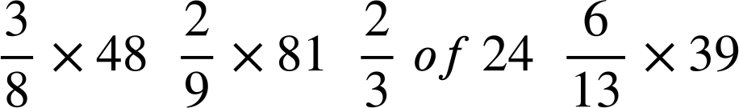

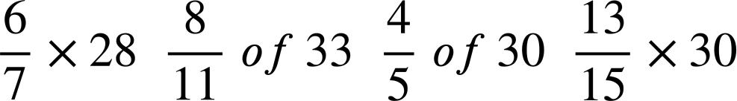

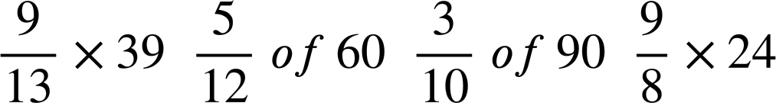

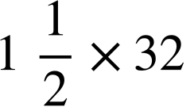

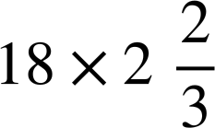


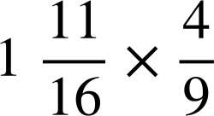
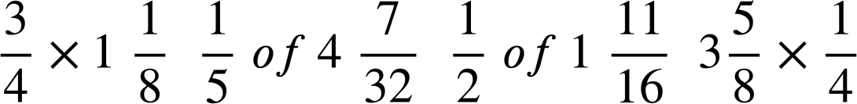




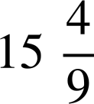
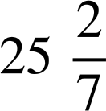
Checking and securing finding a fraction of a given amount
Task B: Fractions of amounts as multiplication
1) Find the odd one out in each row. It has a different answer to the others.
Arrange the letters of these into a word.
A
I
E
U
S
N
Y
R
M
P
W
C
D
E
O
G
T
R
F
H
P
T
L
K
The word is .
Task C: Fractions greater than 1
1) Calculate the following:
a) of 180
b) of 48
c) of 136
d) of 30
e) of 21
v2.2

